Slide 1
Answers Pg 65

Slide 2
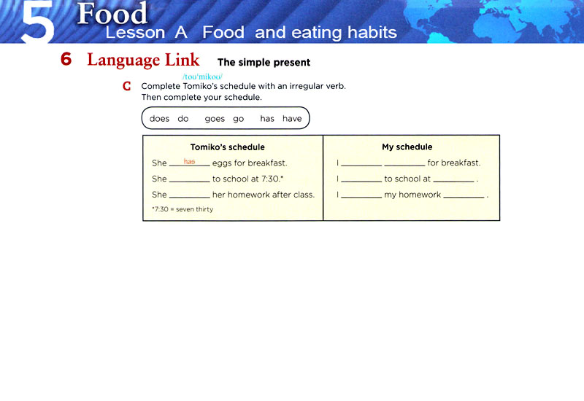
eat
cereal
goes
go
8 a.m.
does
do
at home

Slide 3
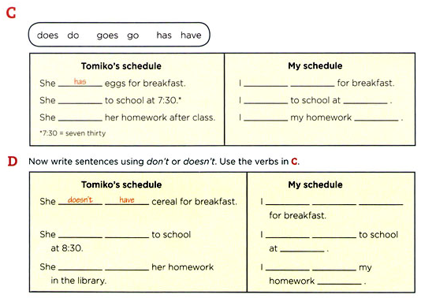
eat
cereal
goes
go
8 a.m.
does
do
at home
don´t
eat
eggs
doesn´t
go
don´t
go
5 a.m.
doesn´t
do
don´t
do
in school

Slide 4
3-8 SPELLING AND PRONUNCIATION OF FINAL -S / -ES
SPELLING
(a) run
runs
rain
rains
scrub
scrubs
love
loves
3rd person singular add -s

Slide 5
3-8 SPELLING AND PRONUNCIATION OF FINAL -S I -ES
SPELLING
(b) sink
sinks
meet
meets
fight
fights
cough
coughs
3rd person singular add -s

Slide 6
3-5 SPELLING AND PRONUNCIATION OF FINAL -ES
-sh, -ch, -ss, -x
SPELLING
-sh
(a) push
pushes
-ch
(b) teach
teaches
-ss
(c) kiss
kisses
-x
(d) fix
fixes
endings
add -es

Slide 7
3-8 SPELLING AND PRONUNCIATION OF FINAL -S I -ES
SPELLING
(c) push
pushes
watch
watches
miss
misses
tax
taxes
-sh, -ch, -ss, -x
3rd person singular add -es

Slide 8
3-8 SPELLING AND PRONUNCIATION OF FINAL -S I -ES
SPELLING
(d) dry
dries
study
studies
consonant + -y
3rd person singular
change y to i, add -es

Slide 9
3-8 SPELLING AND PRONUNCIATION OF FINAL -S I -ES
SPELLING
(e) pay
pays
buy
buys
vowel + -y
3rd person singular
add -s

Slide 10
3-8 SPELLING AND PRONUNCIATION OF FINAL -S I -ES
SPELLING
(f) have
has
go
goes
do
does
3rd person singular forms
irregular

Slide 11
3-5 Let’s Practice
watch
Seung ______ his TV program.
watches

Slide 12
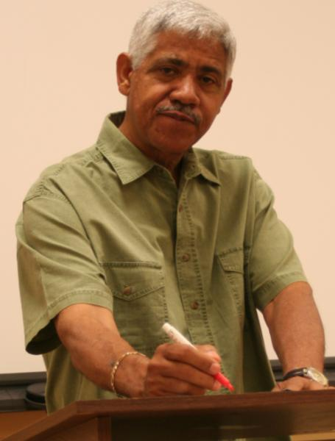
3-5 Let’s Practice
teach
Gerardo _______ math at PUCP
teaches

Slide 13
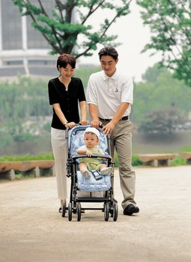
3-6 ADDING FINAL -S / -ES TO WORDS THAT END IN -Y
The baby cries a lot.

Slide 14
3-6 ADDING FINAL -S / -ES TO WORDS THAT END IN -Y
(a) cry
cries
consonant + -y
change y to i,
add -es
fly
flies
(b) pay
pays
vowel + -y
add -s
enjoy
enjoys

Slide 15
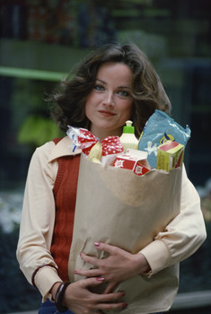
3-6 Let’s Practice
buy
Gazi _________ a lot of food.
buys

Slide 16
3-7 IRREGULAR SINGULAR VERBS: HAS, DOES, GOES
Irregular forms:
she
he
it
(a) I have a hat.
+
has
(b) She has a hat.
have
has
she
he
it
(c) I do homework.
(d) He does homework.
does
+
do
does
she
he
it
(e) We go to the gym.
(f) He goes to the gym.
+
goes
go
goes

Slide 17
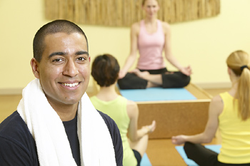
3-7 Let’s Practice
do does
George ____ yoga every day.
does

Slide 18
3-7 Let’s Practice
go goes
Zhou-li ______ for a walk on Sunday.
goes

Slide 19
3-7 Let’s Practice
have has
She always ____ homework.
has

Slide 20
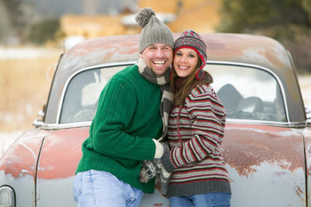
3-9 THE SIMPLE PRESENT: NEGATIVE
They do not wash their car.

Slide 21
3-9 THE SIMPLE PRESENT: NEGATIVE
They
You
We
I
(a) do not drink milk.
I
We
You
They
NEGATIVE:
+ do not + main verb
He
She
It
(b) does not drink milk.
She
He
It
+ does not + main verb

Slide 22
3-9 THE SIMPLE PRESENT: NEGATIVE
I do not drink milk.
She does not drink milk.
do and does = helping verbs
?
She does not drinks milk.
3rd person singular no -s on main verb

Slide 23
3-9 THE SIMPLE PRESENT: NEGATIVE
(c) I don’t drink milk.
They don’t go to the lake.
(d) He doesn’t drink milk.
Jack doesn’t like dogs.
CONTRACTIONS:
do not = don’t
does not = doesn’t

Slide 24
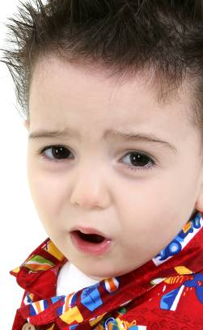
3-9 Let’s Practice
smile not
This child ___________.
doesn’t smile
(use the contraction)

Slide 25
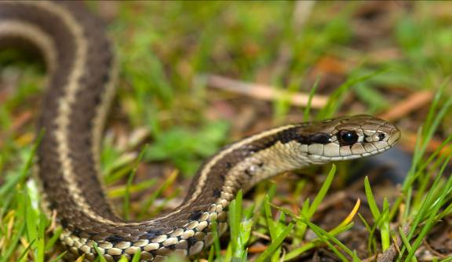
3-9 Let’s Practice
We ________ snakes.
don’t like
like not
(use the contraction)

Slide 26
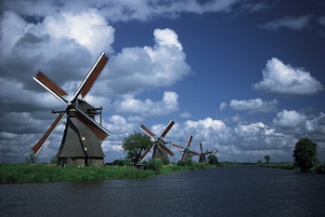
3-9 Let’s Practice
Magda ___________ Dutch.
doesn’t speak
(use the contraction)
speak
not

Slide 27
3-9 Let’s Practice
don’t
doesn’t
eat
jump
run
speak
don’t
eat
Sometimes I ____ ____ my lunch.
My friend _____ it.
eats

Slide 28
3-9 Let’s Practice
don’t
doesn’t
sit
need
like
run
doesn’t
run
She ______ ____ fast at the gym.
She gets tired.

Slide 29
3-9 Let’s Practice
don’t
doesn’t
feed
jump
need
eat
They are good cooks.
need
don’t
They ____ ____ help.

Slide 30
3-1 Let’s Practice
He _______ television in the morning
watches
watch
watches

Slide 31
3-1 Let’s Practice
eat
We ____ lunch at 12:00.
eat
eats

Slide 32
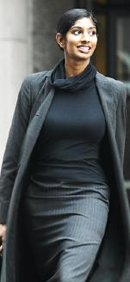
3-1 Let’s Practice
Jara _____ a walk in the morning.
takes
take
takes

